Slide 1
Linked List
A linked list is a form of sequential collection and it does not have to be in order. A Linked list is made of independent nodes that may contain any type
of data and each node has a reference to the next node in the link.
A Node of Linked List
A good comparison in our day to day lives are trains, where each car represent a node connected by links
Each Car is independent (so is each node of a linked list)
To traverse to the last car (tail) of a train we must go through the previous cars (similar in a linked list)
Each car can contain passengers from diff background (diff data types can be stored in a linked list)
The only diff from a train is that the linked list is not stored in a continuous memory location
Data
(17)
Ref to next node
Tail
333
Head
001
1
111
2
222
4
333
5
Null
001
111
222
333
Why Head ??
The first component of a linked list is its head which stores the reference to its first node. It required to access the linked list as it stores its reference.
Why Tail??
To insert a node at the end of a linked list, we’d need to traverse through the whole list which has O(n) time complexity. It’s better to have a tail to
store the reference of the last node to increase the efficiency although it’s not mandatory.

Slide 2
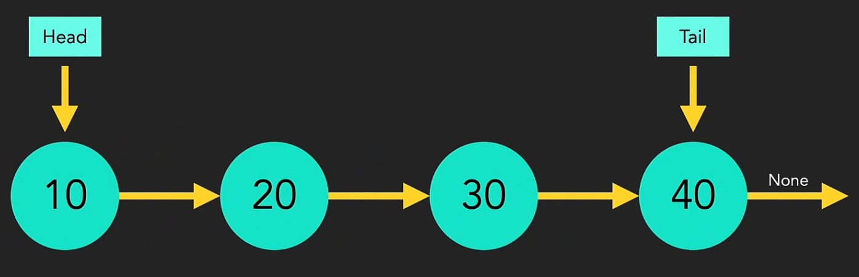
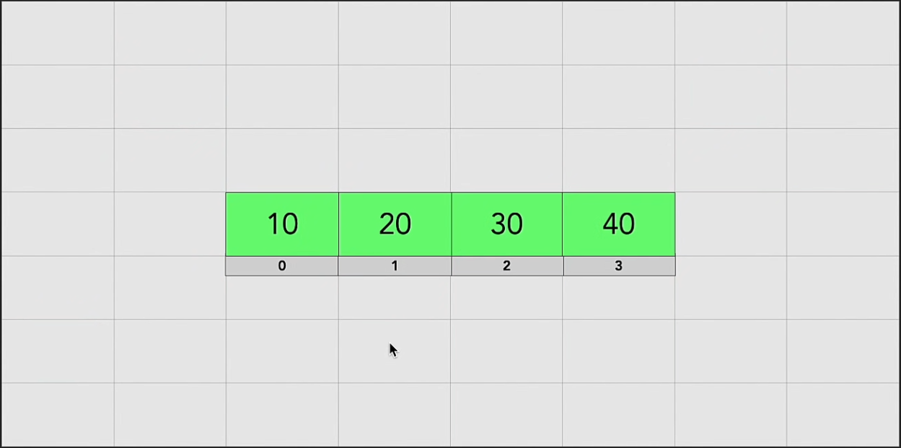
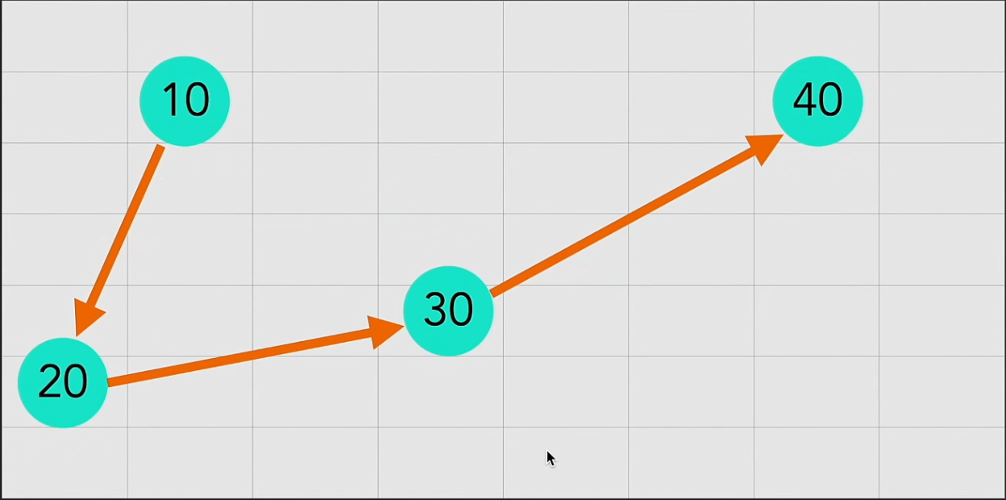
Linked List vs Python Lists / Arrays
Python Lists have indexes while Linked Lists don’t
Python list are contiguous while Linked Lists aren’t stored next to each other
Python Lists in Memory (Contiguous)
Linked Lists in Memory (Non contiguous)

Slide 3
Advantages of Linked Lists over Python Lists
Efficient Insertions and Deletions (in the middle)
- Inserting or deleting in the middle requires shifting all elements after the insertion point — O(n) time.
- Adding or removing a node in the middle or beginning can be done in O(1) time if you already have the reference to that node. You just change the pointers—no shifting of elements.
2. No Need for Contiguous Memory.
- Requires contiguous blocks of memory. If it runs out of space, it has to allocate a bigger block and copy over all elements (which can be costly).
- Nodes can be stored anywhere in memory; they are connected by pointers. This is useful when memory is fragmented.
3. Predictable Performance for Growth
- When it grows beyond capacity, it needs to resize (usually by allocating more space and copying elements).
- No resizing or copying needed when it grows—just add a node.
4. Can Represent Dynamic Data Structures Easily
- possible, but insertions/deletions in the middle are slower.
- Useful for stacks, queues, adjacency lists in graphs, and other custom data structures.

Slide 4
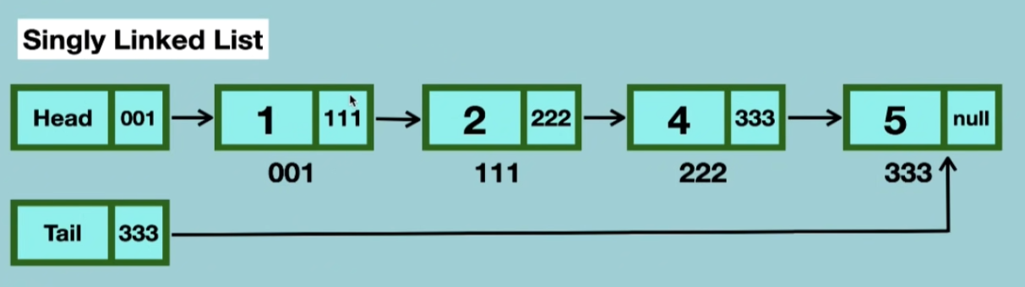
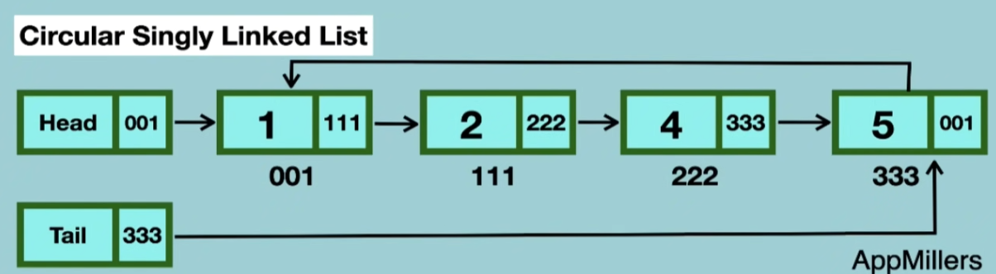
Types of Linked Lists
Singly Linked List
Circular Singly Linked List
Doubly Linked List
Circular Doubly Linked List
Difference between singly linked list and circular singly linked list
Last node in a circular linked list points to the first node which is not the case
with a singly linked list.
Examples of Singly Linked List
Music playlist apps - You can go forward to the next song, but not back.
Image slideshow viewers - Move to the next image only,
useful in memory-efficient systems.
Examples of Circular Singly Linked List
Continuous media players - Loops a video or music playlist without
restarting the program.
- Multi-player board games - Keeps track of player turns in a circle.

Slide 5
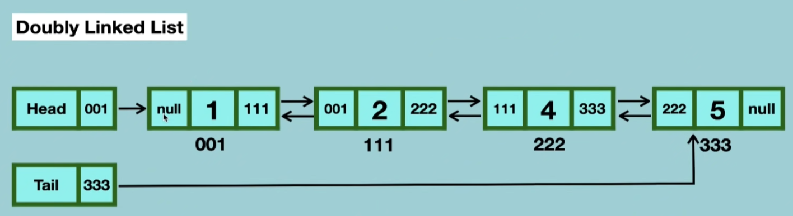
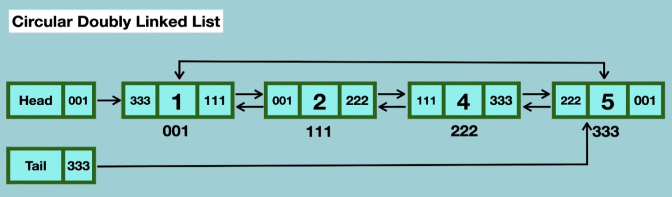
Difference between singly linked list and Doubly linked list
Each node points to the first element which is not the case
with a singly linked list.
Examples of Singly Linked List
Web browsers' back/forward navigation - Move both ways between visited pages.
Image viewers - Navigate to both previous and next images.
Examples of Singly Linked List
Tab switching in browsers - Loop between open tabs in both directions.
Carousel UI components — Scroll infinitely in either direction.

